Slide 1

Skydoc™ Systems, Inc.
Tethered Aerostats & Launch Recovery Systems
www.skydocballoon.com

Slide 2
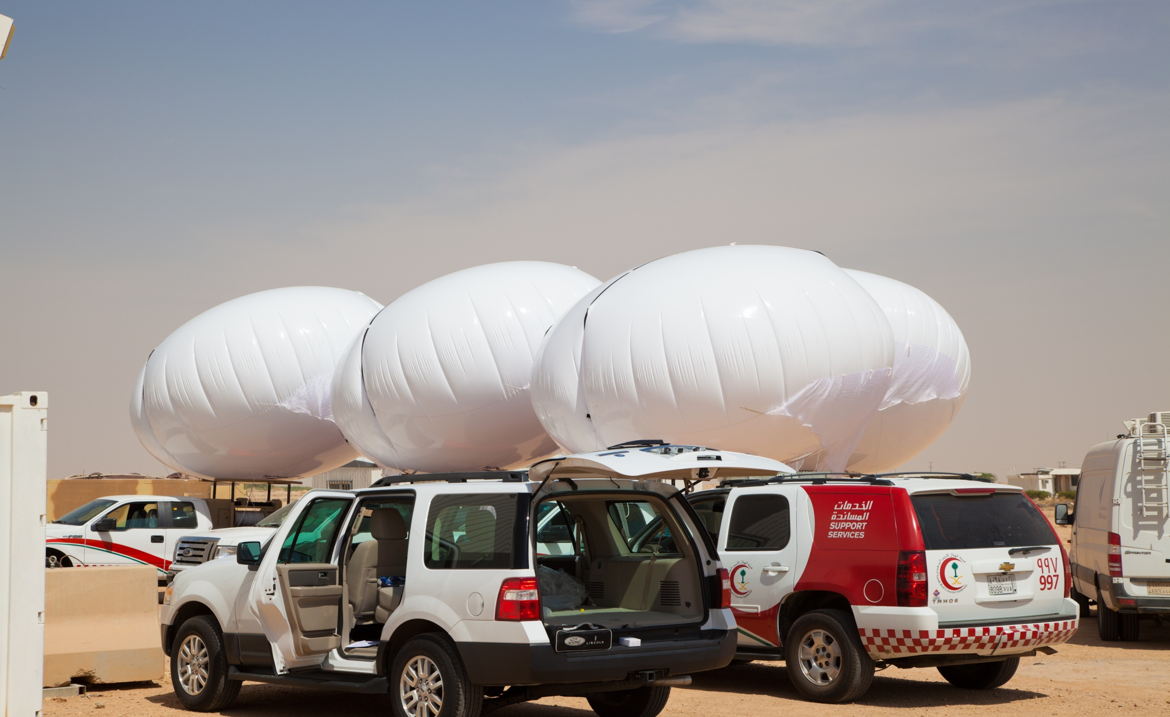
Aerostats—helium-filled, payload-carrying balloons—can provide an aerial 24/7 surveillance and communications with increasing reliability, safety, size and carrying capacity.
Size (and quality) matters: larger and higher quality aerostats can withstand rougher conditions, are safer and more durable, and carry larger, more advanced payloads, ranging from communications sensors, to EO/IR cameras.

Slide 3
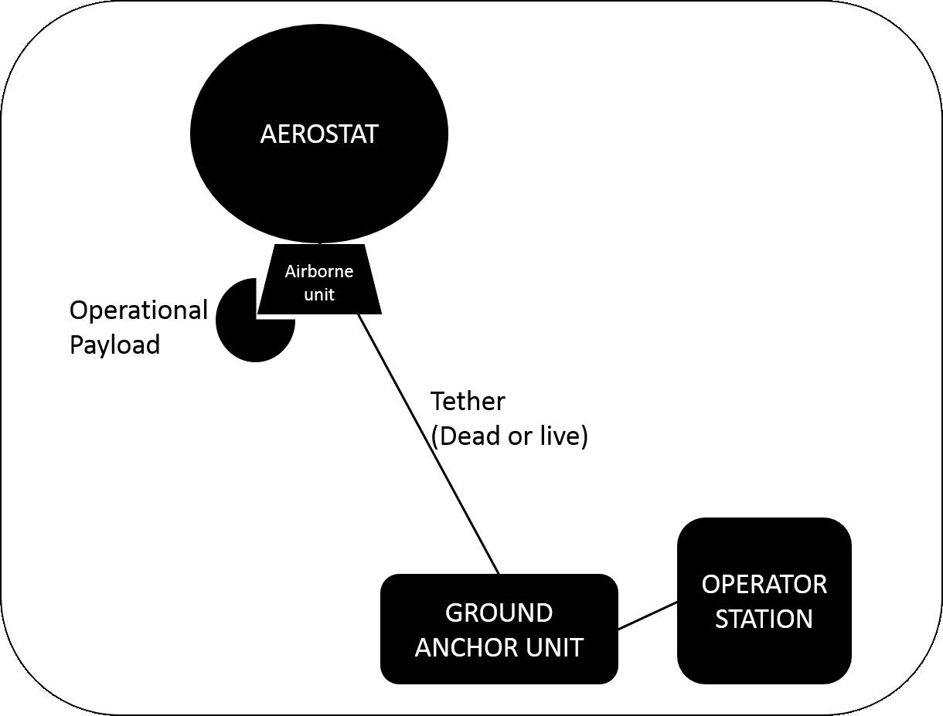
Component sub-systems: A majority of aerostat systems will include several sub-systems (Figure):
The balloon itself (the aerostat)
Various “aerial unit” – the operational payload plus the hardware, communications and power systems needed to run it
Operational payload – the sensors or devices performing the mission (survey, detect, communicate, etc.)
Ground anchor unit that keeps the aerostat in place
Operational station – where the ground controllers operate the system and payload
Helium gas and support equipment to maintain the system over time

Slide 4
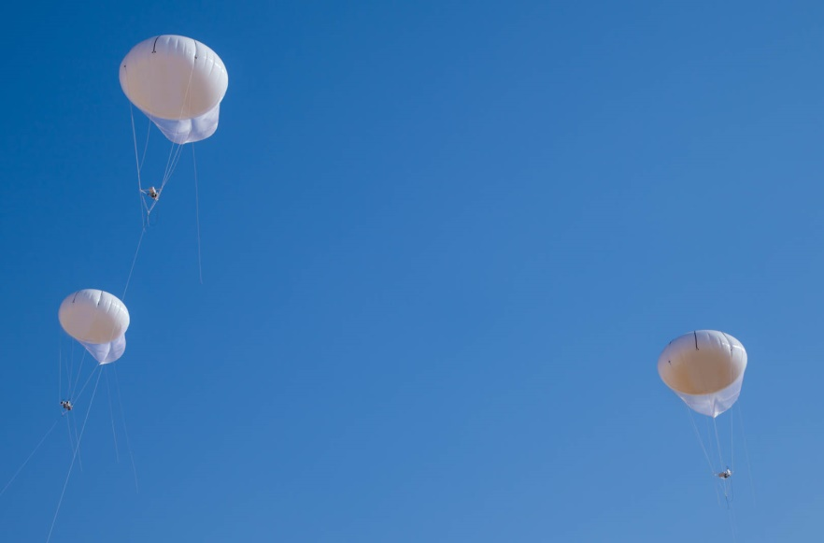
Size/Volume:
The aerostat’s size, and thus its relative gas volume capacity, determines its capacity to lift the platform, cables, supporting gear and payload to its operational altitude. Size matters – larger systems generally carry heavier (read: better, longer-range) payloads and remain airborne in higher altitudes, over longer periods of time and in more challenging weather conditions than smaller ones. As you might expect, this greater capacity usually requires heavier, more complicated support structures, greater manpower and more power and helium.
Payload “carrying capacity”:
The weight that the aerostat can lift beyond its own and its tether’s is its payload carrying capacity. It refers to both the “operational” payload, such as a camera, and the supporting systems that must be airborne with it (e.g. power, communication, computing, lights, etc.)
Operational altitude:
The operational altitude is the “above ground” altitude at which the system is expected to operate while carrying the designated payload weight. Lift, and thus operational altitude, may change with external conditions, such as air pressure, and operators can lift the system to various altitudes within system limitations.

Slide 5
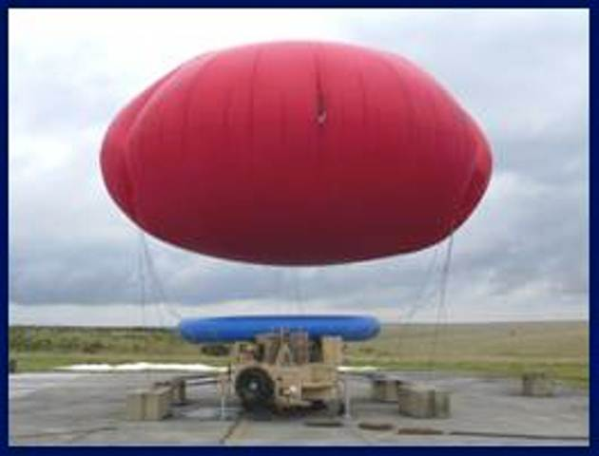
Choosing a system
When considering aerostats for surveillance or communications applications, teams should investigate a range of systems (various designs, sizes, mobile and stationary) with respect to their mission, particularly in the expected area of operation. Aerostats range from small systems flown at altitudes less than 304m (1,000ft), carrying payloads under 20kg for a short range, to heavy, long-range systems elevated up to 608m (2,000’), carrying large payloads over 20kg with longer range surveillance or communications.

Slide 6
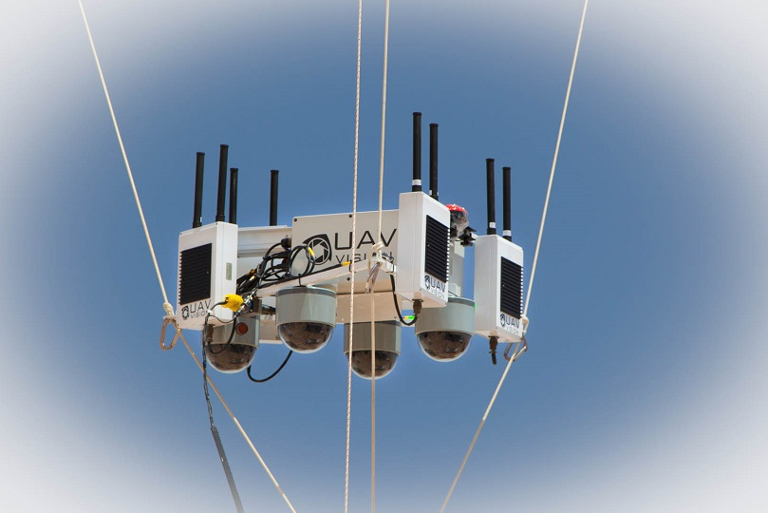
Operational Payloads:
Aerostats are open platforms that, depending on the model and design, can carry a great variety of mission payloads.
Most deployed aerostats carry electro-optical (day and night cameras) or communication (e.g. relay) payloads.
Aerostat platform characteristics such as size, power and communication determine the expected payload carrying capacity and flight altitude. Larger aerostat systems with a continuous power source can carry larger, heavier payloads over longer periods of time.
The operational “range” depends on the characteristics of both the aerostat platform (flight altitude) and the payload itself.
  The range depicted in many promotional materials relies on a specific manufacturer’s combination of components, under standardized conditions.
  The same aerostat platform may be able to carry different payloads, depending on needs, design of the platform, station, and payload, and conditions.

Slide 7
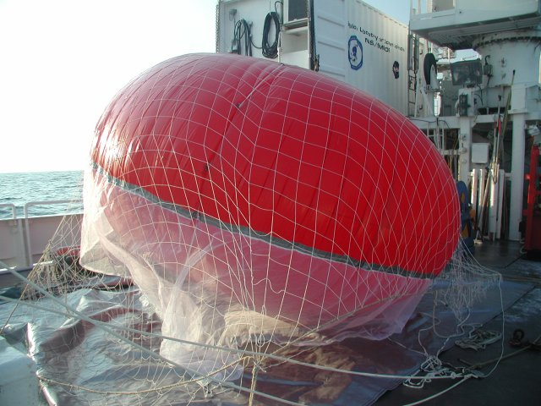
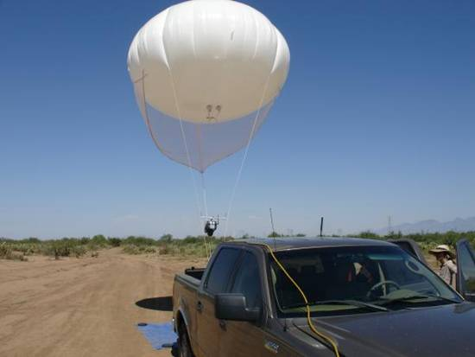
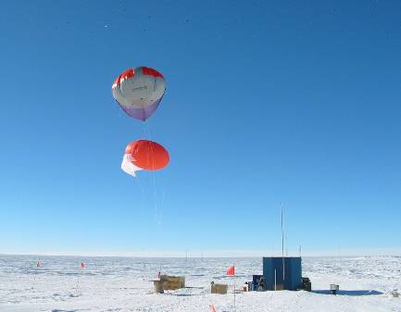
Limitations, Quality and Safety:
Aerostat systems are designed to be used in the field over long periods of time. Quality of design and manufacturing are critical to ensure satisfactory field performance over time.
Systems of any size that are designed to meet military standards are usually highly reliable and superior quality but carry a much greater cost.
Wind, air pressure, and rain are the main external factors affecting and limiting aerostat system operation.
Generally speaking, quality is indicated by the system’s ability to remain airborne over longer periods of time, in harsher weather conditions while transmitting quality payload data in the required view range.
Larger, higher-quality systems require additional training and safety protocols to ensure the safe and efficient operation of both the aerostat (platform) and the mission (payload).
Any system running day and night requires operators (for aerostat and payload) in shifts that will be vigilant enough to detect and respond to any disturbance.
The helium used for a given aerostat must match the required quality and be available in sufficient and regular supply for continuous routine operation.
Helium supply must be included in calculating the long-term cost of maintaining an aerostat system.
Helium fueling/refueling requires an anchoring of the system (it cannot be done while airborne).

Slide 8
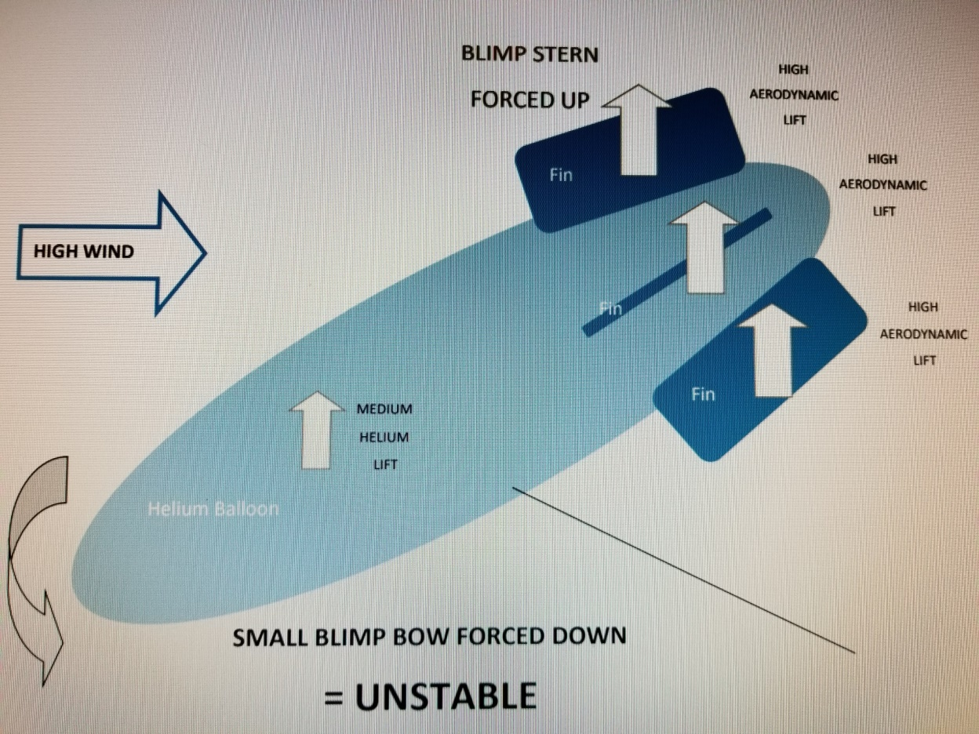
Blimp stability in windy conditions
Winds:
Very large 'blimp' aerostats can sometimes remain stable in high winds due to their massive helium lift at the bow that combats the wind. However, these very large blimps are hugely expensive and uneconomical for almost any activity. For small, less expensive blimps, the helium lift at the bow is far smaller, thus reducing blimps wind-keeping capability. This is a major reason why small blimps cannot cope with high winds. Thus large blimps that have some wind-keeping ability are too expensive, and small blimps that are more economical to use cannot cope with high winds.

Slide 9
Specification Information on SkyDoc™ Aerostat Products
Launcher:
Versatility
  Ground Based Platform
  Specialized Trailer with power for use in remote locations
  Width and height designed for Flatbed and Pickup Truck mobility
  Designed for transport in CH46, CH53 or fixed wing aircraft
  Equipped with lifting rings for transport by helicopter
  Used as on-site control center or relay to remote command station
Equipment
  Continuous power to payload with powered aerostat tether
  Adaptable for HMMWV, 120/220VAC, 12V or generator electrical input
  Onboard air conditioning for electrical/electronic components cooling
Components
  Aerostat cradle for secure storage or safe movement between locations
  Winch to launch and retrieve aerostat
  All electrical/electronic components to operate payload
  Temperature controlled equipment compartment
  On board battery bank and generator (2kw or 5kw) with fuel storage
  Lighting source (white and red) as needed for on site operations
  Storage compartments for helium bottles, cradle, aerostat, portable lighting and extra equipment

Slide 10
Specification Information on SkyDoc™ Aerostat Products
Aerostat:
Single ply material used for all but extreme weather conditions
  Material is polyurethane and can be 3mil, 6mil or 9mil thickness
  Helium loss can be up to one per cent per day depending on temperature swings and aerostat pressure
  The aerostat design allows for additional lift with increased wind speed and has been flown in 110 mph without incident
  Welders grade helium is preferred
  Variety of colors available
Multi-ply material used for extreme weather conditions
  The multiple ply SkyDoc™ Aerostat has all the attributes of the single ply
  Helium loss is comparable to the single ply aerostat
  Material design is a multi-layered material with inner and outer coating for use in extreme cold weather conditions
  Pressure relief valve will open with increased pressure caused by increased temperature
Tether:
Varies in breaking strength characteristics from 250lbs (112kg) to 5000lbs (2250kg)
  Embedded copper wire #18 gauge up to #24 gauge is available
  Single optical fibers available
  Material is Spectra strength braid with polyester outer coating
  Total weight of tether is dependent on breaking strength requirements, altitude desired, if embedded copper wire/optical fiber needed

Slide 11
Specification Information on SkyDoc™ Aerostat Products
Winch:
Description:
  Large frame – 4 ½ “ (11.43cm) drum, 17” (43.18cm) drum ends
  Directional switch
  Various AC or DC motors available
  Electrical and/or fiber optic slip ring available for tether power to payload
  Motor brake available
  3.25 Worm Center Gear Box available with
    60:1 @ 1725 RPM, 35’ (10.6m), 1000lbs (450kg) pull
    30:1 @ 3450 RPM, 70’ (21.3m), 650lbs (292.5kg) pull
Vertical Winch:
Outside Dimensions: 32.18” Width – 31.09” Height – 22.18” Depth – 350lbs net weight
Winch dimensions: 8.5” Drum diameter – 9” Drum width – 18” Drum flanges
Drum tether capacity: 1529’ of 0.28” tether with .5” Freeboard
Electrical slip ring and Ethernet connection
15' (4.5m) Winch control pendant
Control panel to include: DC meter, main DC ON/OFF switch
Shore power breaker to connect external 120VAC to the DLS-30/IQ4 battery charger
Main DC ON/OFF switch turns the winch on and off
Battery charger DLS-30/IQ4 will connect directly to the battery 30-amp battery charger
2 SLA-1175 Marine deep cycle 75AH to provide DC power
1 each standard 120VAC 15amp shore power input receptacle
Quick disconnect panels for ease of maintenance
Manual (quick throw) emergency stop handle

Slide 12
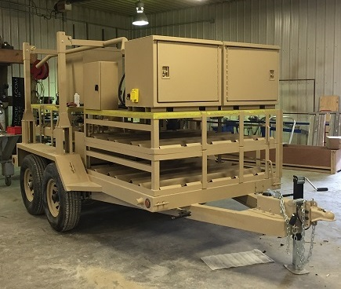
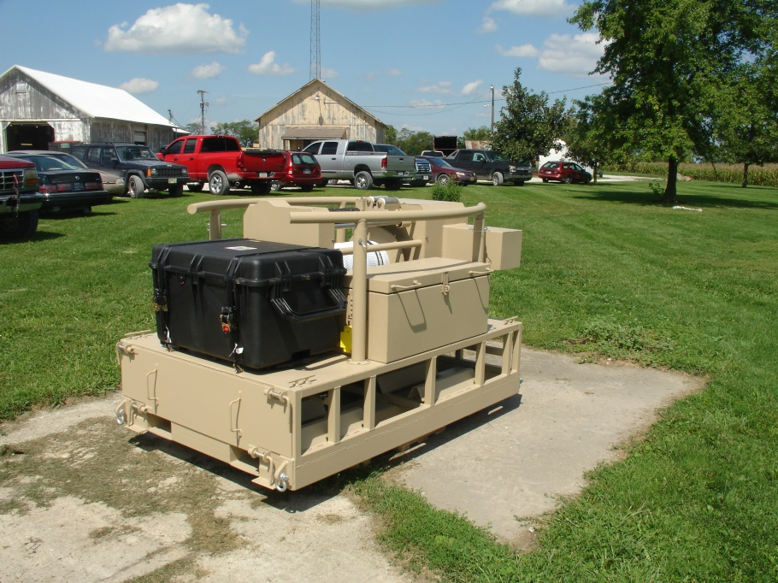
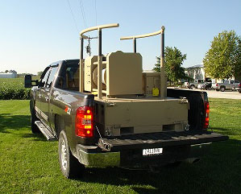
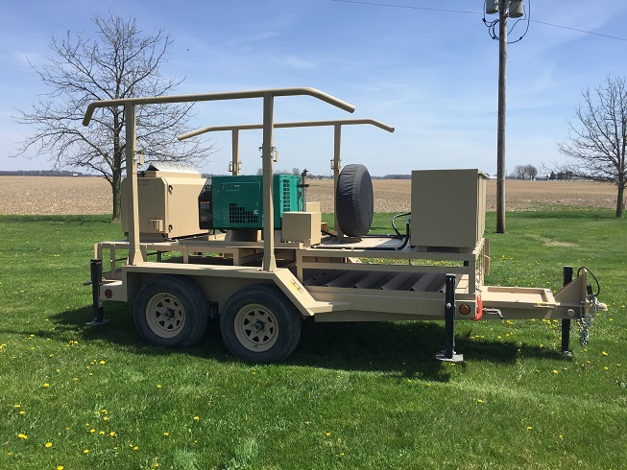
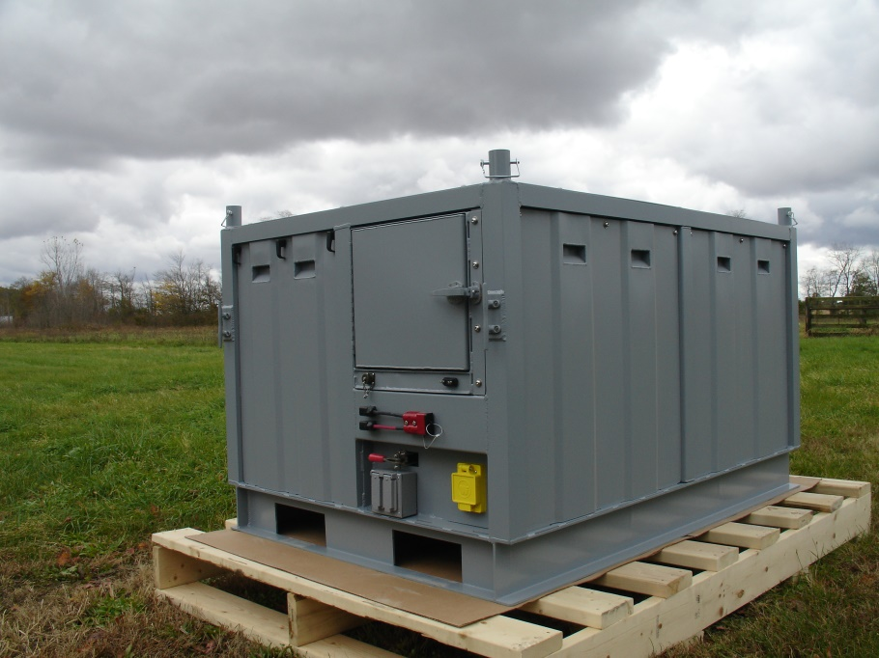
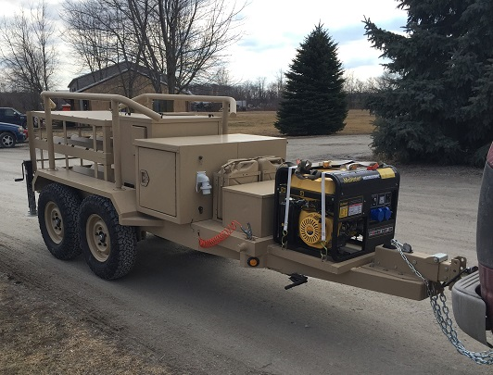
Aerostat Launch/Recovery Options

Slide 13
